Slide 1

“ Analysis of true wireless Earbuds with rating above 4 star on flipkart ”
Presented By : 1.Sumit Dhanve
2.Om Raut

Slide 2
Introduction
Why This Project ?
Provides Market Insights: Reveals trends in popular brands, pricing, and customer ratings.
Offers Consumer Guidance: Helps potential buyers make informed decisions.
Demonstrates Data Analysis Skills: Showcases abilities in web scraping, data cleaning, and visualization.
Identifies Product Trends: Highlights which features or attributes are associated with high ratings or prices.

Slide 3
Objective Of The Project
Extract and analyze true wireless headphone data from Flipkart.
Identify key market trends (brands, ratings) among top sellers.
Visualize findings to reveal consumer preferences.
Deliver actionable insights for product understanding

Slide 4
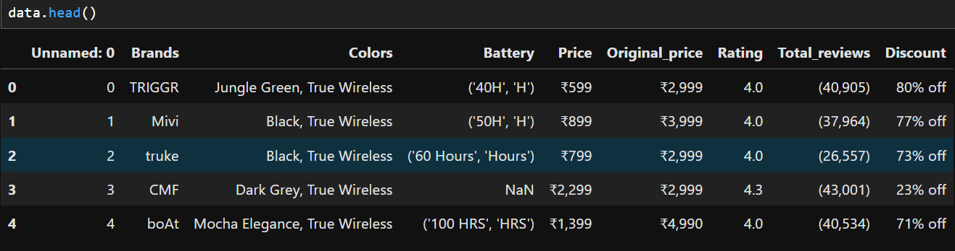
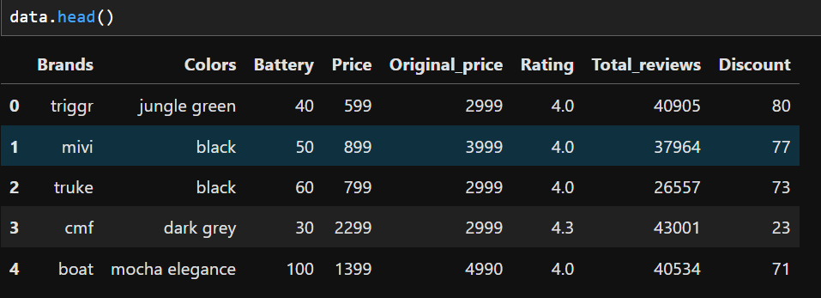
Dataset Overview :
Contains product details like price, original price, discount, rating, reviews, and battery life.
Includes categorical data: brand and color.

Slide 5
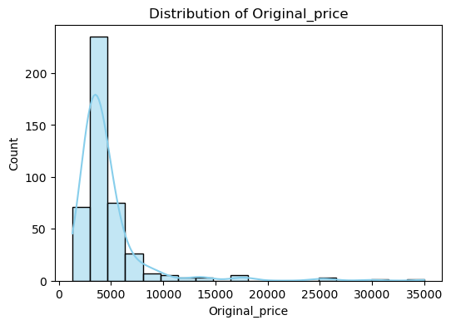
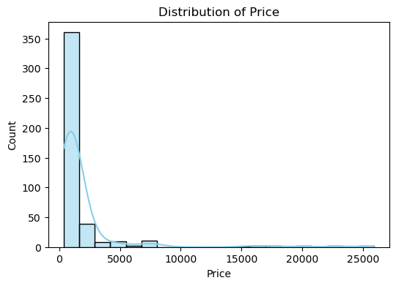
Distribution of Key Features
This shows that discounts are prevalent, and the actual selling price is significantly lower than the original price.
The price distribution is highly right-skewed, meaning most products are priced at the lower end, with a few high-priced outliers.
budget-friendly or mid-range products dominate the market

Slide 6
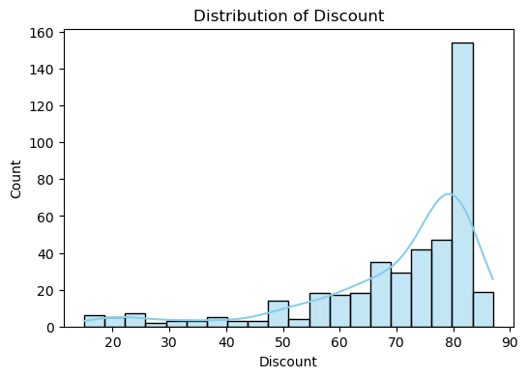
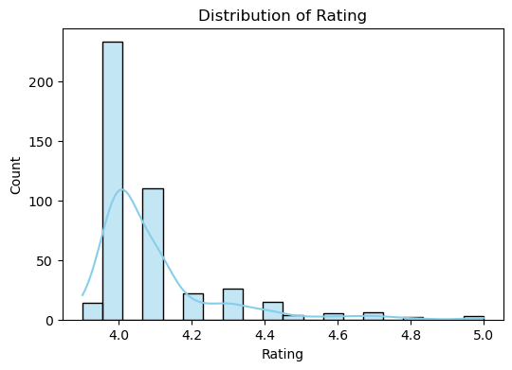
The discount distribution shows a peak around 80%, indicating that many products have high discounts.
discounts are offered in particular range(60-85)% mostly
Most ratings cluster around 4.0–4.2, indicating that the majority of wireless headphones are rated favorably.
Very few products have ratings below 4.0 or above 4.5, suggesting a narrow range of user sentiment.

Slide 7
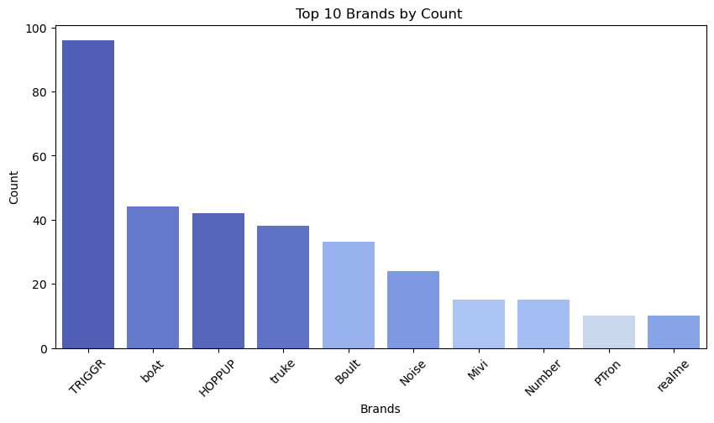
Top 10 brands
Trigger has the highest count, meaning it dominates the market in terms of available products.
Brands like boAt, HOPPUP, and truke also have significant counts, indicating popular choices in the wireless headphones market.

Slide 8
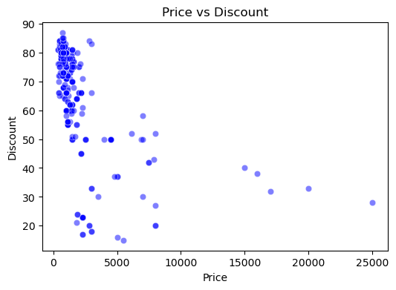
Do Product with Higher Price Have more Discounts ?
Products with a lower price tend to have a higher discount, while premium products get lower discounts.
Many mid-range products have significant discounts.
Ex: 50% of 1000 < 20%10000
Hence the answer to question is No product with lower price has higher discount

Slide 9
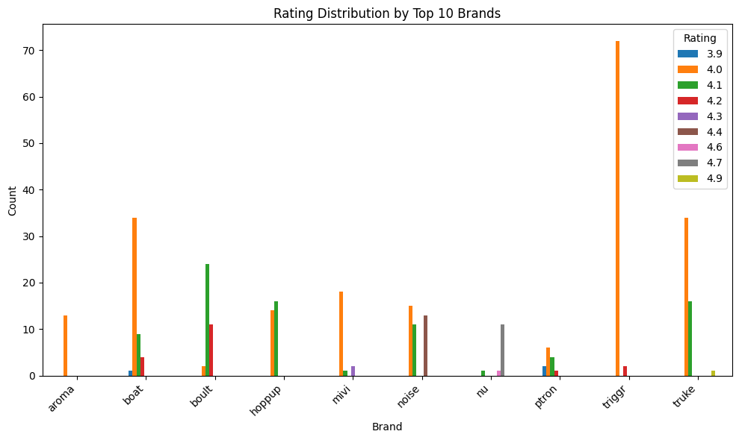
Rating Distribution OF Brands
4.0 and 4.1 ratings are the most common across most brands, indicating a generally positive customer experience.
The rating patterns help differentiate brands in terms of perceived quality or customer satisfaction.
Some brands (aroma, mivi, triggr) show a high degree of consistency with a single dominant rating, while others (boat, boult, noise, ptron, truke) have a wider spread.

Slide 10
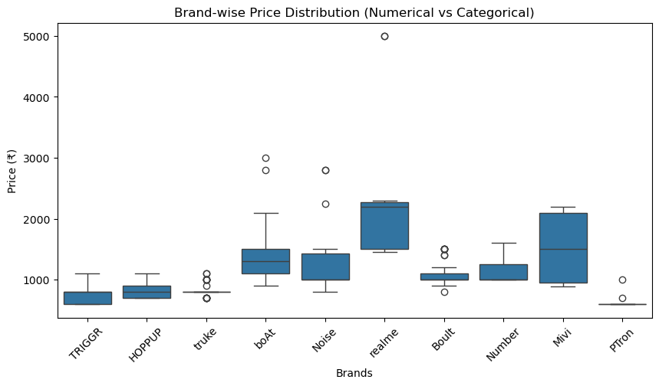
Brand-wise Price Distribution:
Realme and Mivi have the highest price ranges, with several high-priced models.
TRIGGR, HOPPUP, and Boult fall within a lower price range, suggesting they cater to budget buyers.
Some brands show a wider variation in price (e.g., Noise, Realme),
indicating both budget and premium models exist.

Slide 11
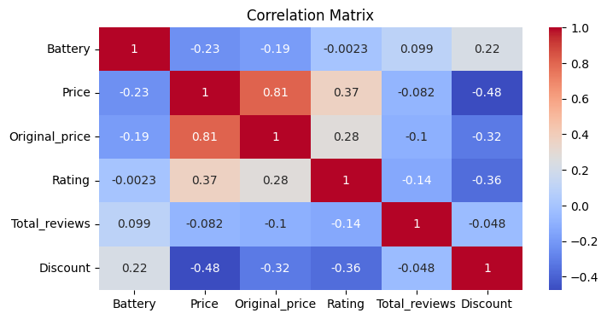
Correlation Analysis
Strong Positive Correlation Between Price and Original Price
Negative Correlation Between Price and Discount
Weak Negative Correlation Between Rating and Discount
Total Reviews Have Little Correlation with Other Factors
Price and Discount show a weak correlation.
High correlation between Total Reviews and Rating.

Slide 12
Key Insights :
Majority of wireless headphones are under ₹5000 with significant discounts.
Budget-friendly headphones dominate the market
Heavy discounts are a common pricing strategy.
Ratings are generally high (above 4.0), indicating customer satisfaction.
Some brands offer a wider range of prices, others stick to budget-friendly models.
Price is not the main factor affecting ratings, other factors like brand perception and features play a role

Slide 13

THANK YOU

